Slide 1



Tasty Tales
UIP-TERMWORK
1
2
Dheer Sheth
Tejas Shetty
16010421101
16010421103

Slide 2


Problem Definition
Tasty Tales ,where culinary exploration meets innovation! is more than just a collection of recipes; it's a dynamic culinary journey designed to ignite your passion for cooking, inspire your creativity, and elevate your dining experience.
It serves as a hub where users can discover, learn, and share a wide range of recipes, cooking techniques and can cook dishes simultaneously at their homes.

Slide 3



Uniqueness
This website will provide the user with interactive timers. Users can set timers for tasks like marinating, baking, or simmering. This feature ensures they don't miss any step and their dishes turn out perfectly cooked.
How our app is better than others and what unique feature do we provide which makes our app a real standout amongst our competitors
Tasty tales will allow user to join a new community or create their own community where they can post their own variations of a certain recipe and can add comments to other recipes. They can also participate in cooking competitions organized.
We will also allow user to compare his food with the original recipe. Users can click a picture of their food and AI can give suggestions on them

Slide 4



PERSONAS
Who are the customers you want to cater to?
Brian Age: 30
George Age: 45
Occupation: Graphic Designer
Occupation: Marketing Manager
Enjoys cooking as a creative outlet. Always looking for new and interesting recipes to try. Values easy-to-follow instructions and visually appealing food photography. Often cooks for his family and likes to experiment with different cuisines. Prefers to inspire more peeps to join cooking through varios communities
Limited time for cooking due to a demanding job. Seeks quick and healthy recipes. Prefers mobile-friendly access to recipes and meal planning tools. Needs recipes that can be prepared in under 30 minutes. Doesn’t follow the ordinary recipe schedule and may need an interactive timer to get his work done.

Slide 5
USE CASES
Meal Planning: Users can find recipes to plan their meals for the week, catering to specific dietary preferences and restrictions.
Recipe Bookmarks: Users can save their favorite recipes for quick access in the future.
Cooking Tips: This app often offer cooking techniques, tips, and tricks to improve culinary skills.
User Ratings and Reviews: Users can read and contribute to recipe reviews, helping others choose tried-and-true dishes.
Community and Discussion: This app has a community features for users to discuss cooking and share experiences.

Slide 6
WHY FIGMA
Collaboration: Figma is a cloud-based tool that allows real-time collaboration. Multiple users can work on a design simultaneously, making it ideal for teams working remotely or across different locations.
Prototyping: Figma allows you to create interactive prototypes, helping you visualize the user experience and interactions within your wireframes.
Plugins and Integrations: Figma has a growing ecosystem of plugins and integrations that enhance its functionality, such as user testing, code generation, and more.
Community and Resources: Figma has a strong community and many online resources, tutorials, and templates available, making it easy to learn and get support.
Responsive Design: Figma supports responsive design, making it easier to design for different screen sizes and devices.

Slide 7

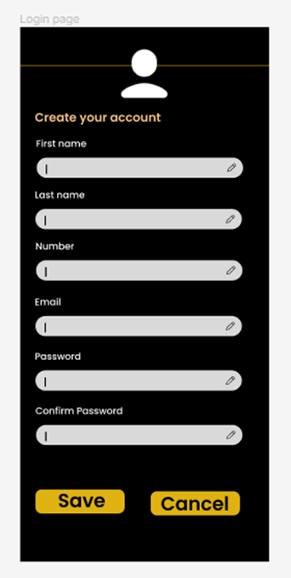
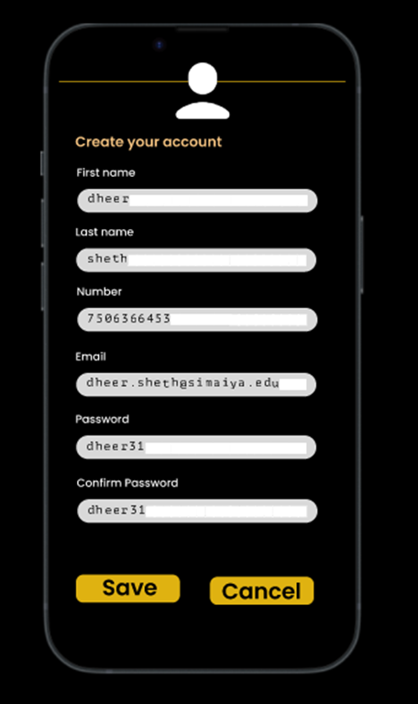
IN PAGE EDITING
Single-Field Inline Edit
The simplest type of In-Page Editing is when editing a single field of text inline. The editing happens in place instead of in a separate window or on a separate page.

Slide 8

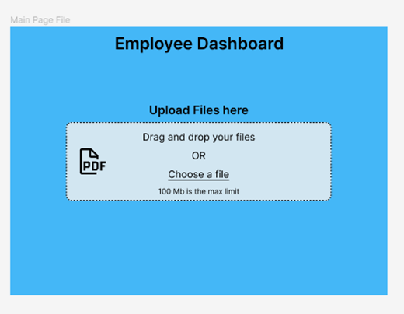
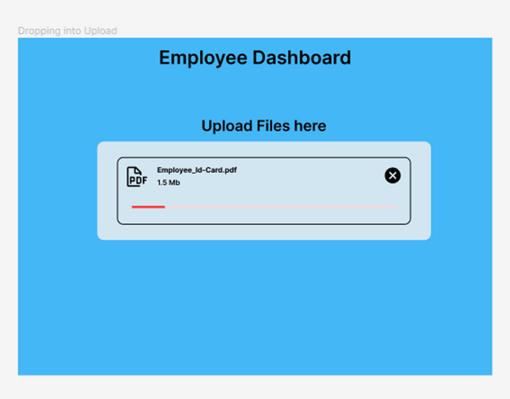

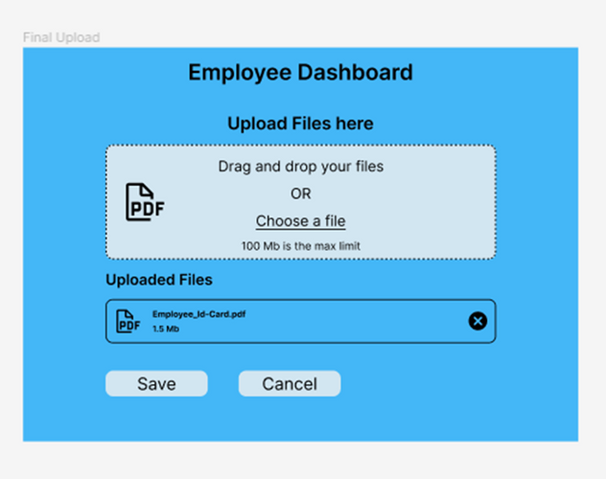
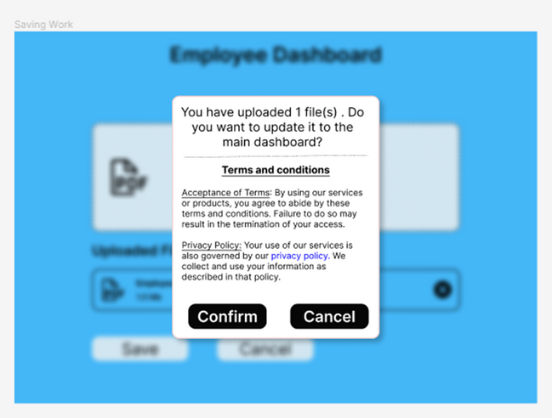
DRAG AND DROP

Slide 9
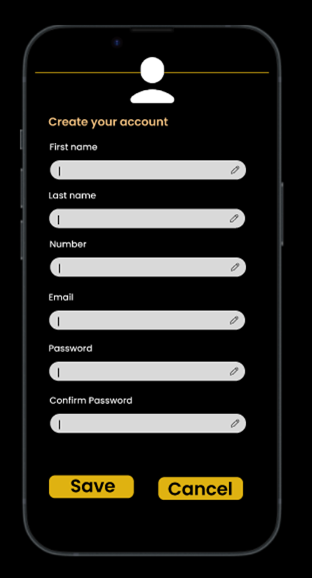
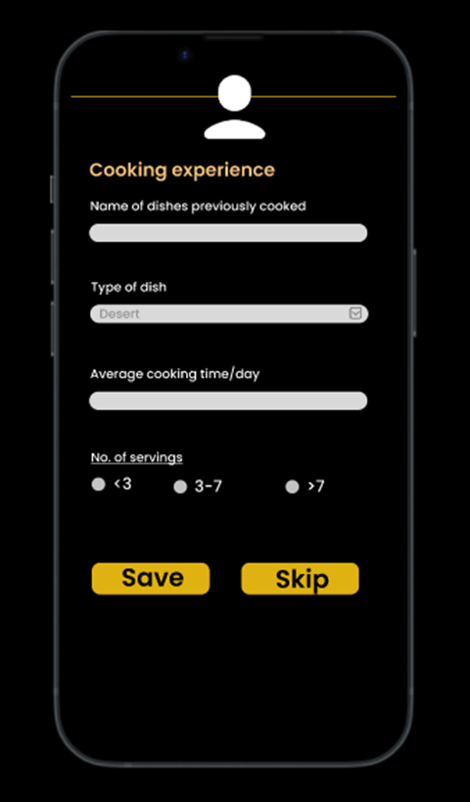
FORM DESIGNS
The patterns, techniques, and controls described here apply mostly to form design . Form interface requests a specific kind of text input from the user, formatted in a certain way. We have also inculcated different input types such as drop down and radio buttons in our form

Slide 10
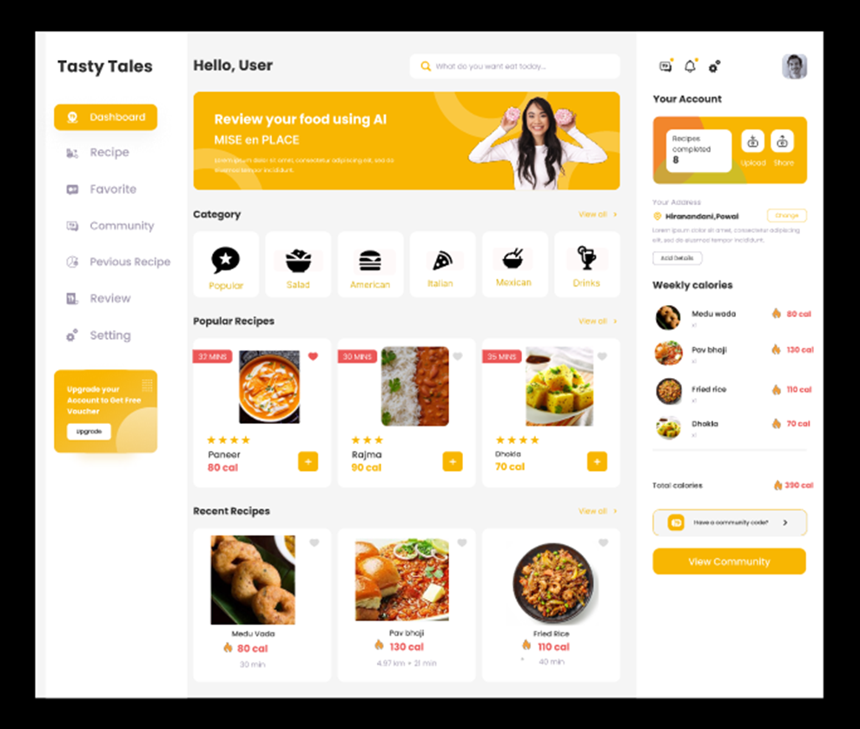
DASHBOARD
Dashboard arranges data, displays into a single information-dense page, updated regularly. It shows users relevant, actionable information, and let them customize the display as necessary.Dashboard determines what information users need or want to see. Uses a good visual hierarchy to arrange lists, tables, and information graphics on the page

Slide 11
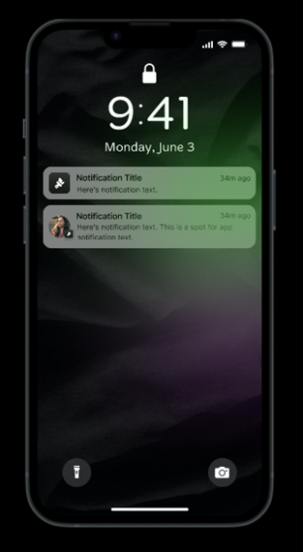
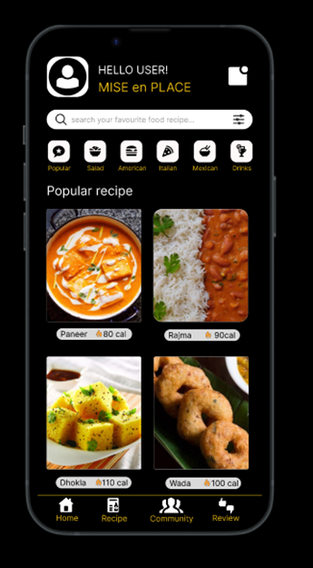
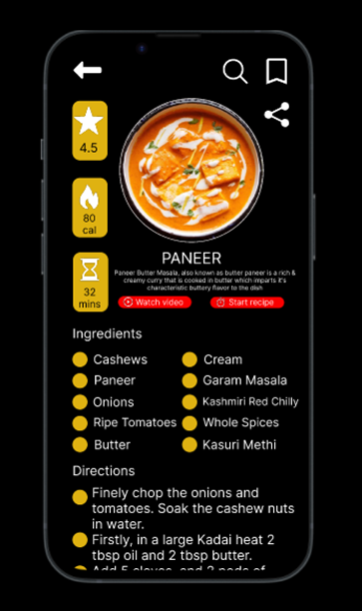
MOBILE-UI

Slide 12
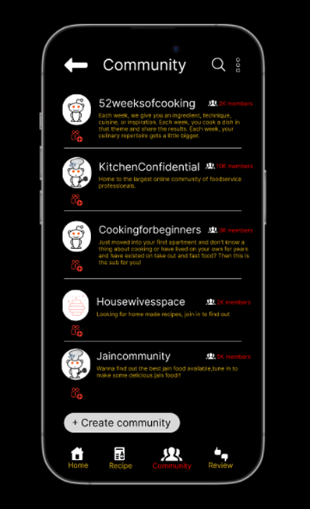
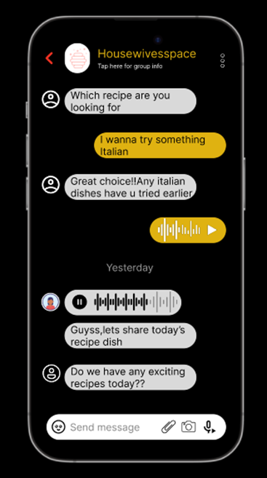
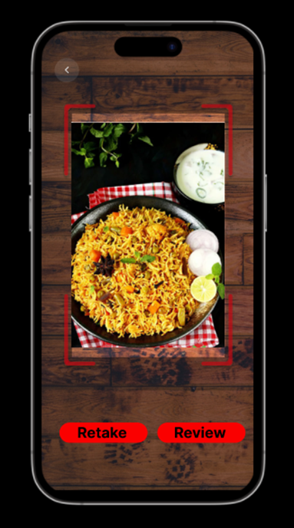
MOBILE-UI DISPLAY OF INFORMATION

Slide 13
Thank You
CLICK HERE FOR DESIGN

